Slide 1
Welcome to the Otta Broker Portal
Your guide to getting started
FOR BROKERS
Notes:
Welcome to the Otta Broker Portal. Your guide to getting started.

Slide 2
Getting started in five steps
1
Set your password
2
Find your way around
3
Complete or send a form
Use the link in your welcome email. It works for 7 days.
Your dashboard shows quotes, policies and renewals at a glance.
Fill it in online, or send your client a secure link.
4
Track it
5
Ask us anything
See every application and quote, and bind accepted quotes.
Help & contact puts you straight through to the underwriters.
Notes:
Getting started in five steps. 1. Set your password: Use the link in your welcome email. It works for 7 days. 2. Find your way around: Your dashboard shows quotes, policies and renewals at a glance. 3. Complete or send a form: Fill it in online, or send your client a secure link. 4. Track it: See every application and quote, and bind accepted quotes. 5. Ask us anything: Help & contact puts you straight through to the underwriters.

Slide 3
Signing in
01
Your account is ready. Here's how to get in, now and next time.
Notes:
Signing in. Your account is ready. Here's how to get in, now and next time.

Slide 4
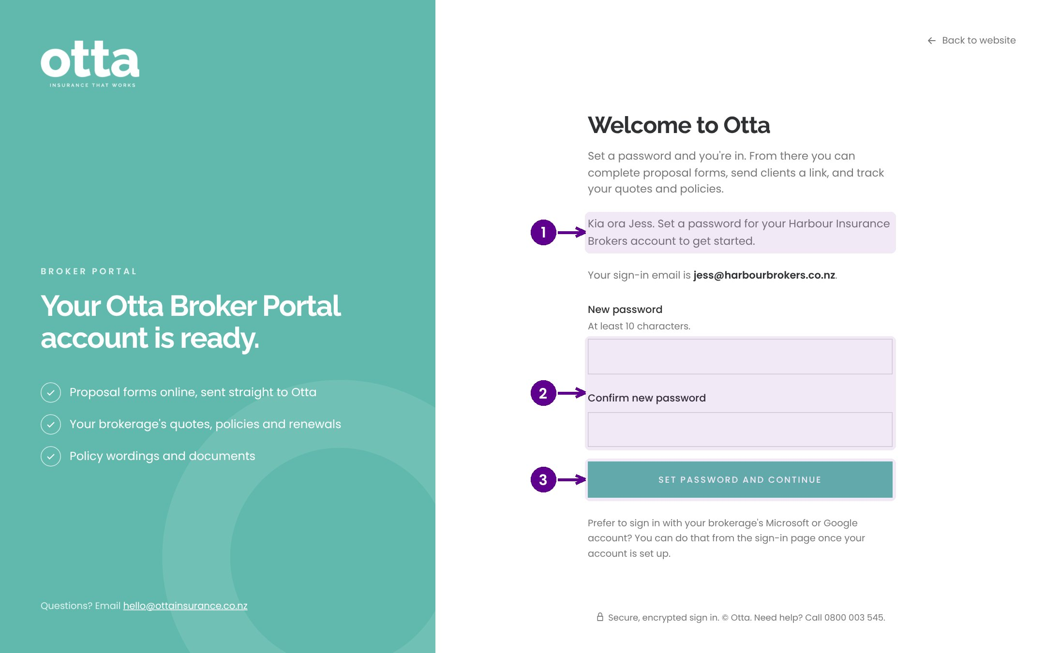
Set your password
1
Open the link in your welcome email.
2
Choose and confirm a password.
3
Select Set password. You're in.
Notes:
Your welcome email has a link to set your password. It works for 7 days. If it has expired, email yourself a sign-in link from the sign-in page or ask us to resend it.

Slide 5
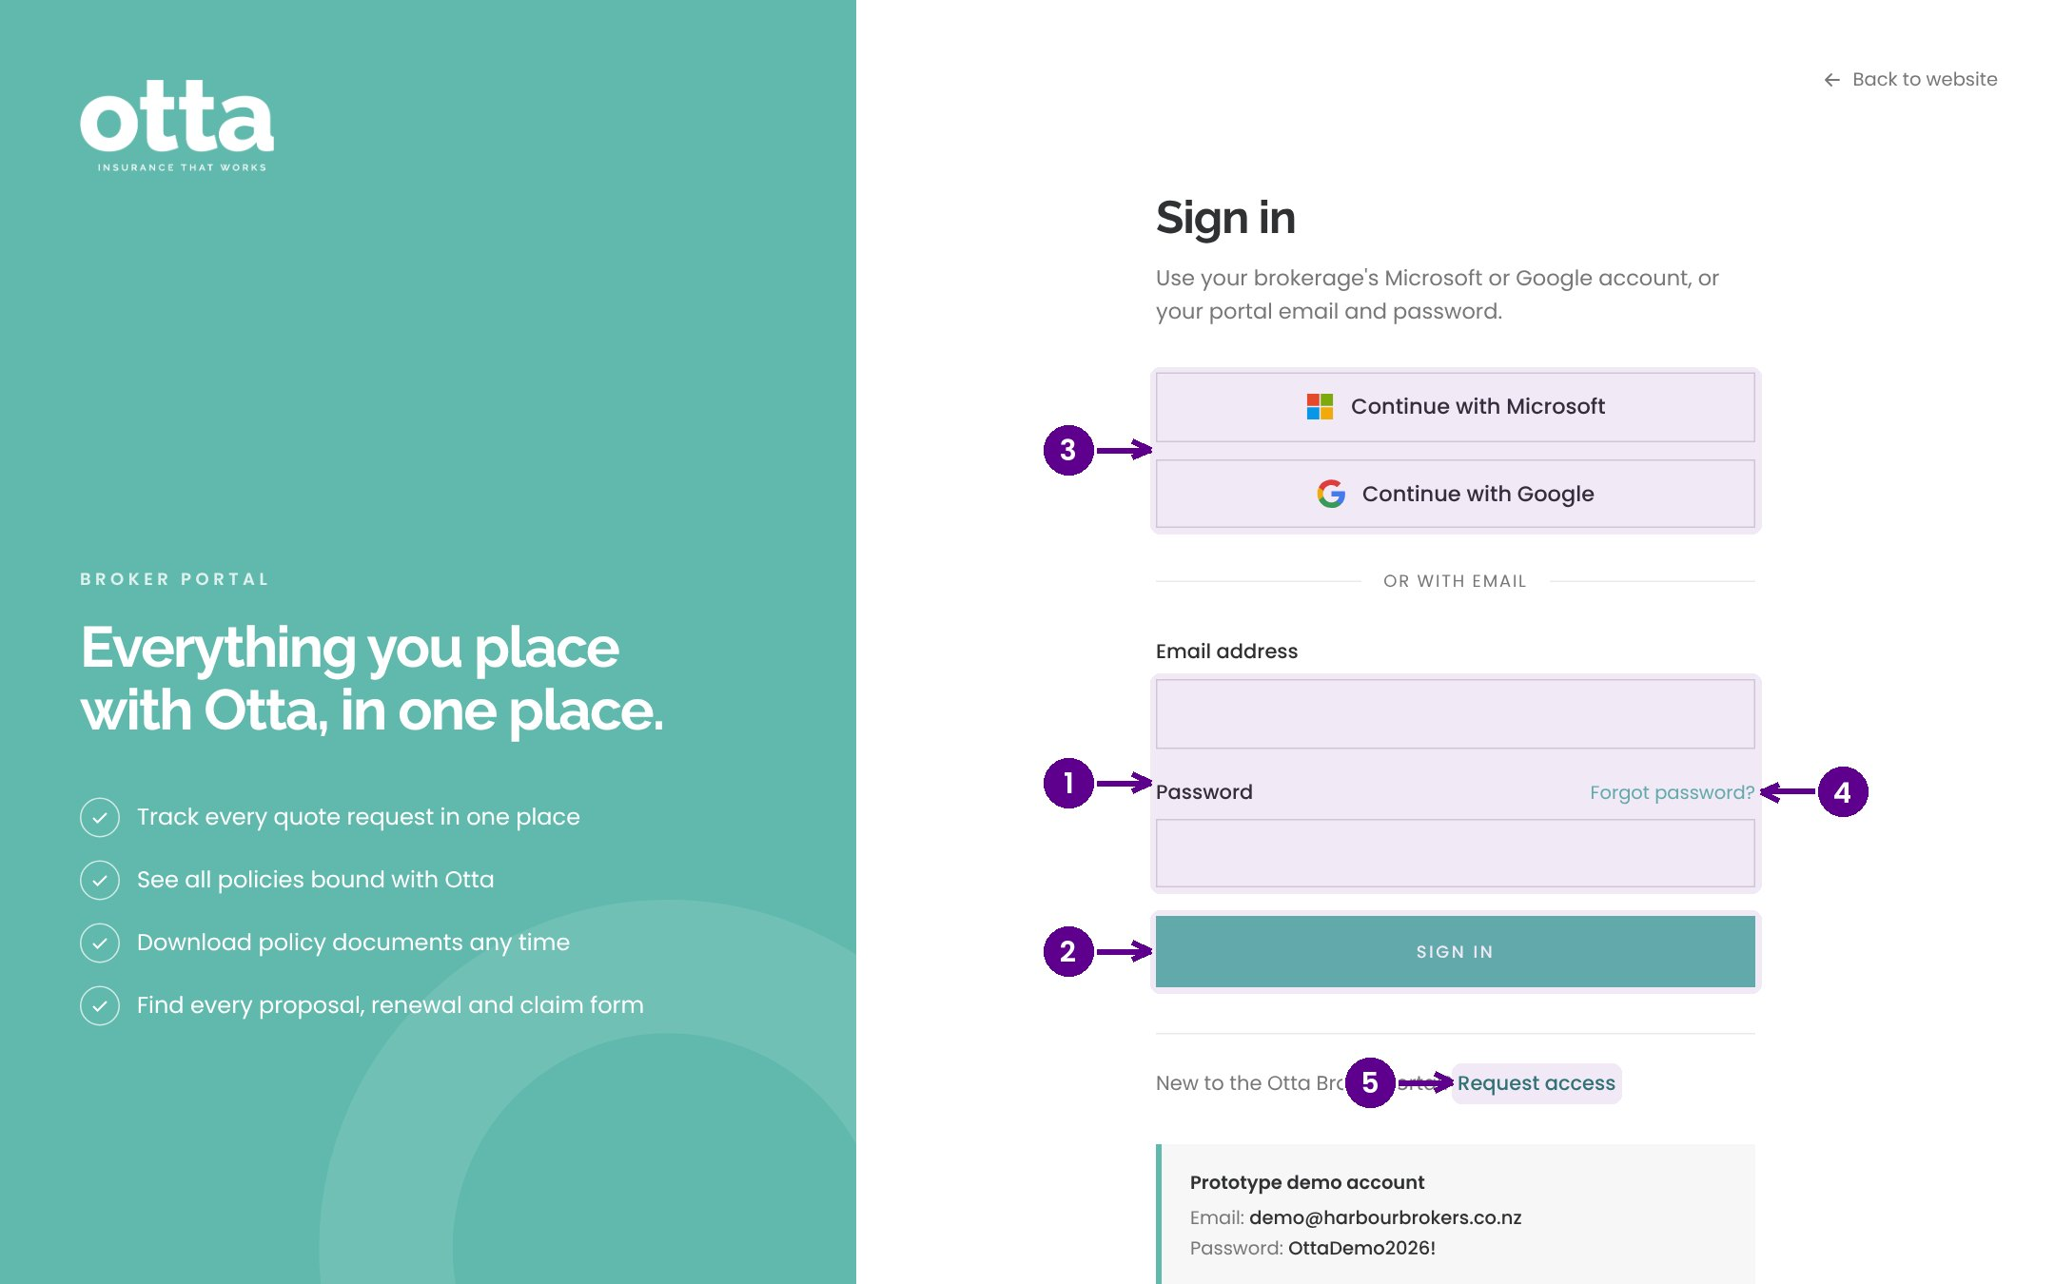
Signing in next time
1
Your work email and password.
2
Select Sign in.
3
Or use your Microsoft or Google work account.
4
Forgotten your password? Email yourself a sign-in link.
5
Colleagues can request their own access here.
Notes:
Sign in at the broker portal with your email and password, or with your Microsoft or Google work account. If you forget your password, ask for a sign-in link by email.

Slide 6
Your dashboard
02
Everything you have with Otta, on one page.
Notes:
Your dashboard. Everything you have with Otta, on one page.

Slide 7
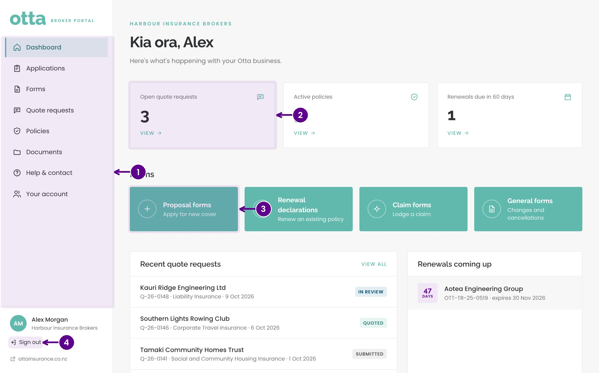
Your dashboard
1
The menu takes you to every part of the portal.
2
Your open quote requests, active policies and renewals due.
3
Shortcuts to proposal forms, renewal declarations, claim forms and general forms.
4
Sign out when you're done.
Notes:
Your dashboard shows your open quote requests, active policies and renewals due in the next 60 days, with shortcuts to the forms you'll use most.

Slide 8
Applying for cover
03
Complete a form yourself, or send it to your client to fill in.
Notes:
Applying for cover. Complete a form yourself, or send it to your client to fill in.

Slide 9
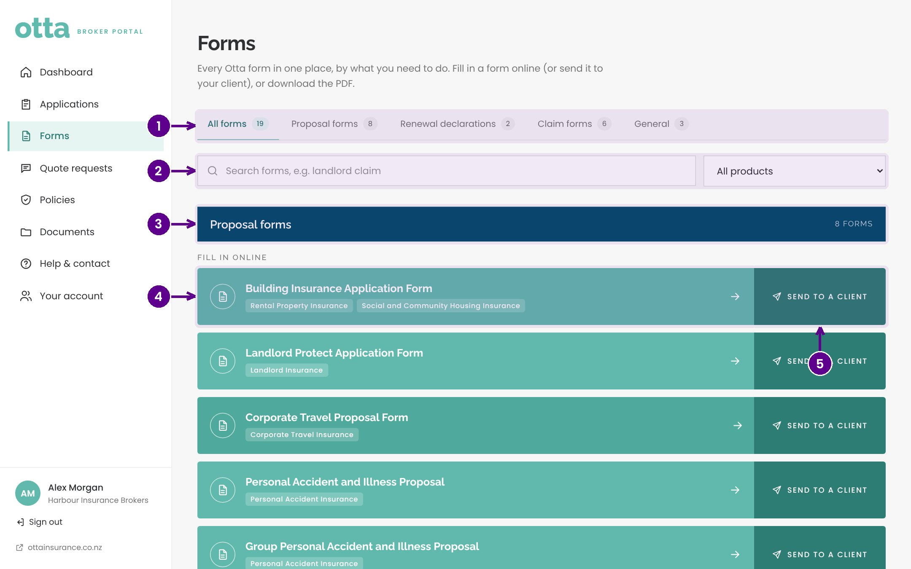
Finding the right form
1
Choose proposal forms, renewal declarations, claim forms or general forms.
2
Search, or filter by product.
3
Forms are grouped by product.
4
Select a form to complete it online.
5
Or send it to your client.
Notes:
Forms holds every Otta form, grouped by product. Online forms are listed first, and any PDF only forms can be downloaded.

Slide 10
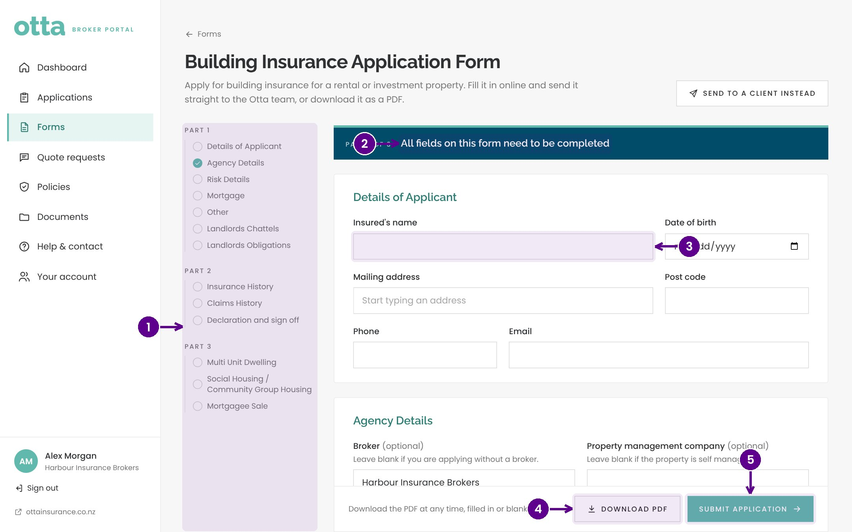
Completing a form online
1
Jump to any section.
2
Each section is clearly headed.
3
Fill in the answers.
4
Download a PDF copy at any time.
5
Submit. It goes straight to the right Otta team.
Notes:
Work through the sections in any order. Download a PDF copy whenever you like. When you submit, it goes straight to the underwriting team and appears in your Applications.

Slide 11
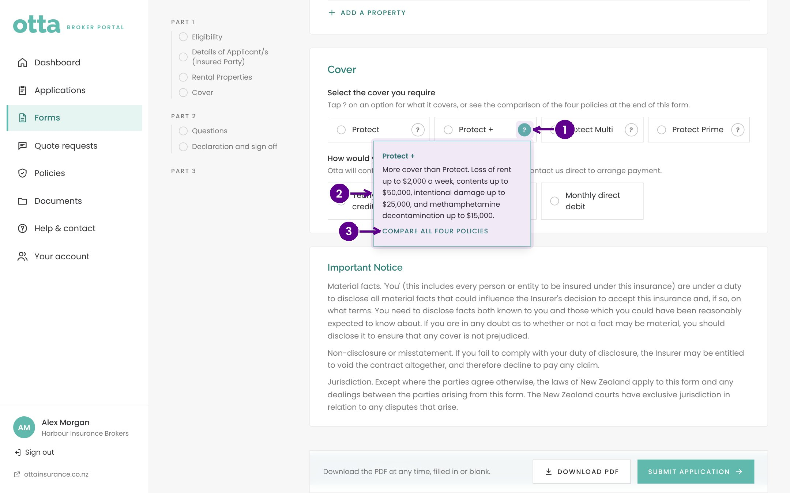
Not sure which cover?
1
Select the question mark beside an option.
2
A short explanation of the cover.
3
A link to the policy wording.
Notes:
Where a form offers several cover options, the question mark explains each one and links to the wording.

Slide 12
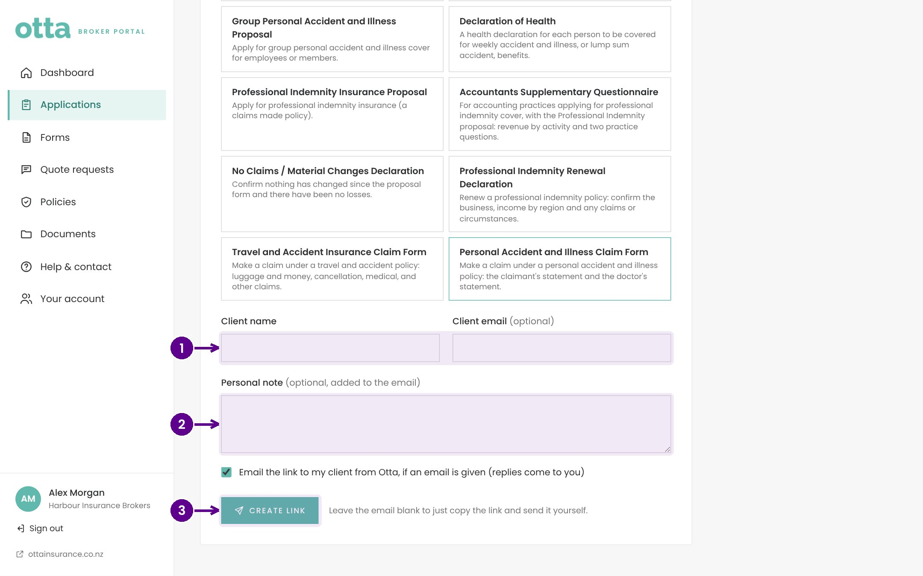
Sending a form to your client
1
Your client's name and email.
2
An optional note, added to the email.
3
Create link. We email your client, and replies come back to you.
Notes:
Choose the form, then add your client's details. We email them a secure link that works for 30 days. When they submit, it comes straight to Otta and shows in your Applications. Leave the email blank to copy the link and send it yourself.

Slide 13
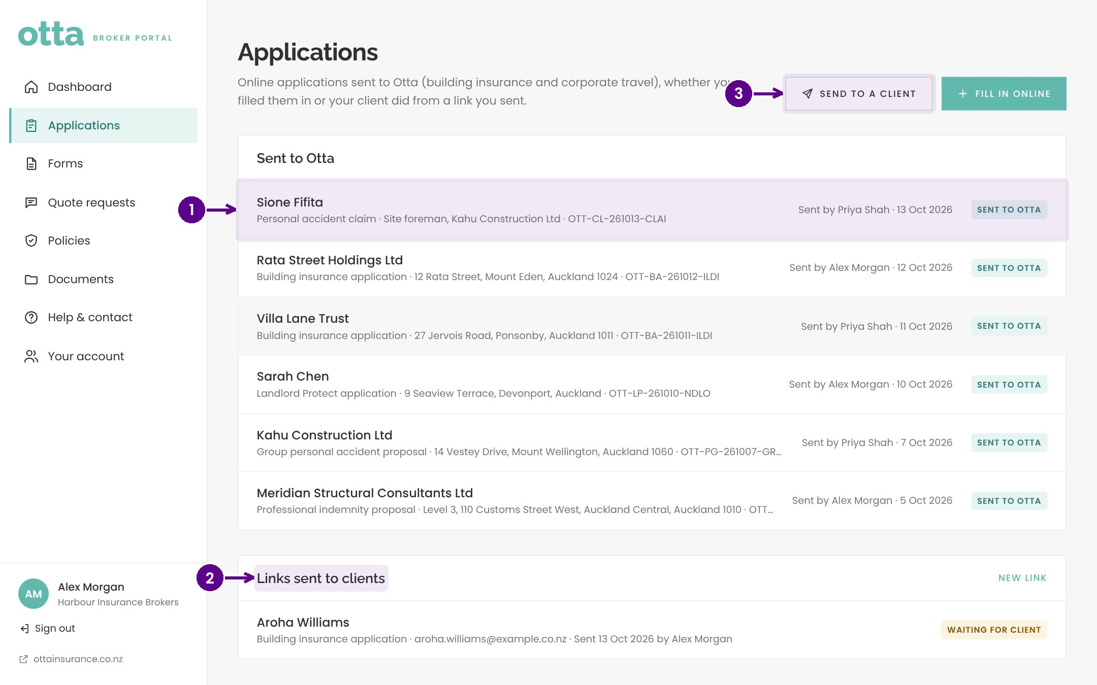
Tracking applications
1
Everything sent to Otta, by you or your clients.
2
Links you've sent to clients, and whether they're done.
3
Send another form, or fill one in online.
Notes:
Applications shows everything you and your clients have sent us, and every link you've sent with its status.

Slide 14
Quotes and policies
04
From quote to bound policy.
Notes:
Quotes and policies. From quote to bound policy.

Slide 15
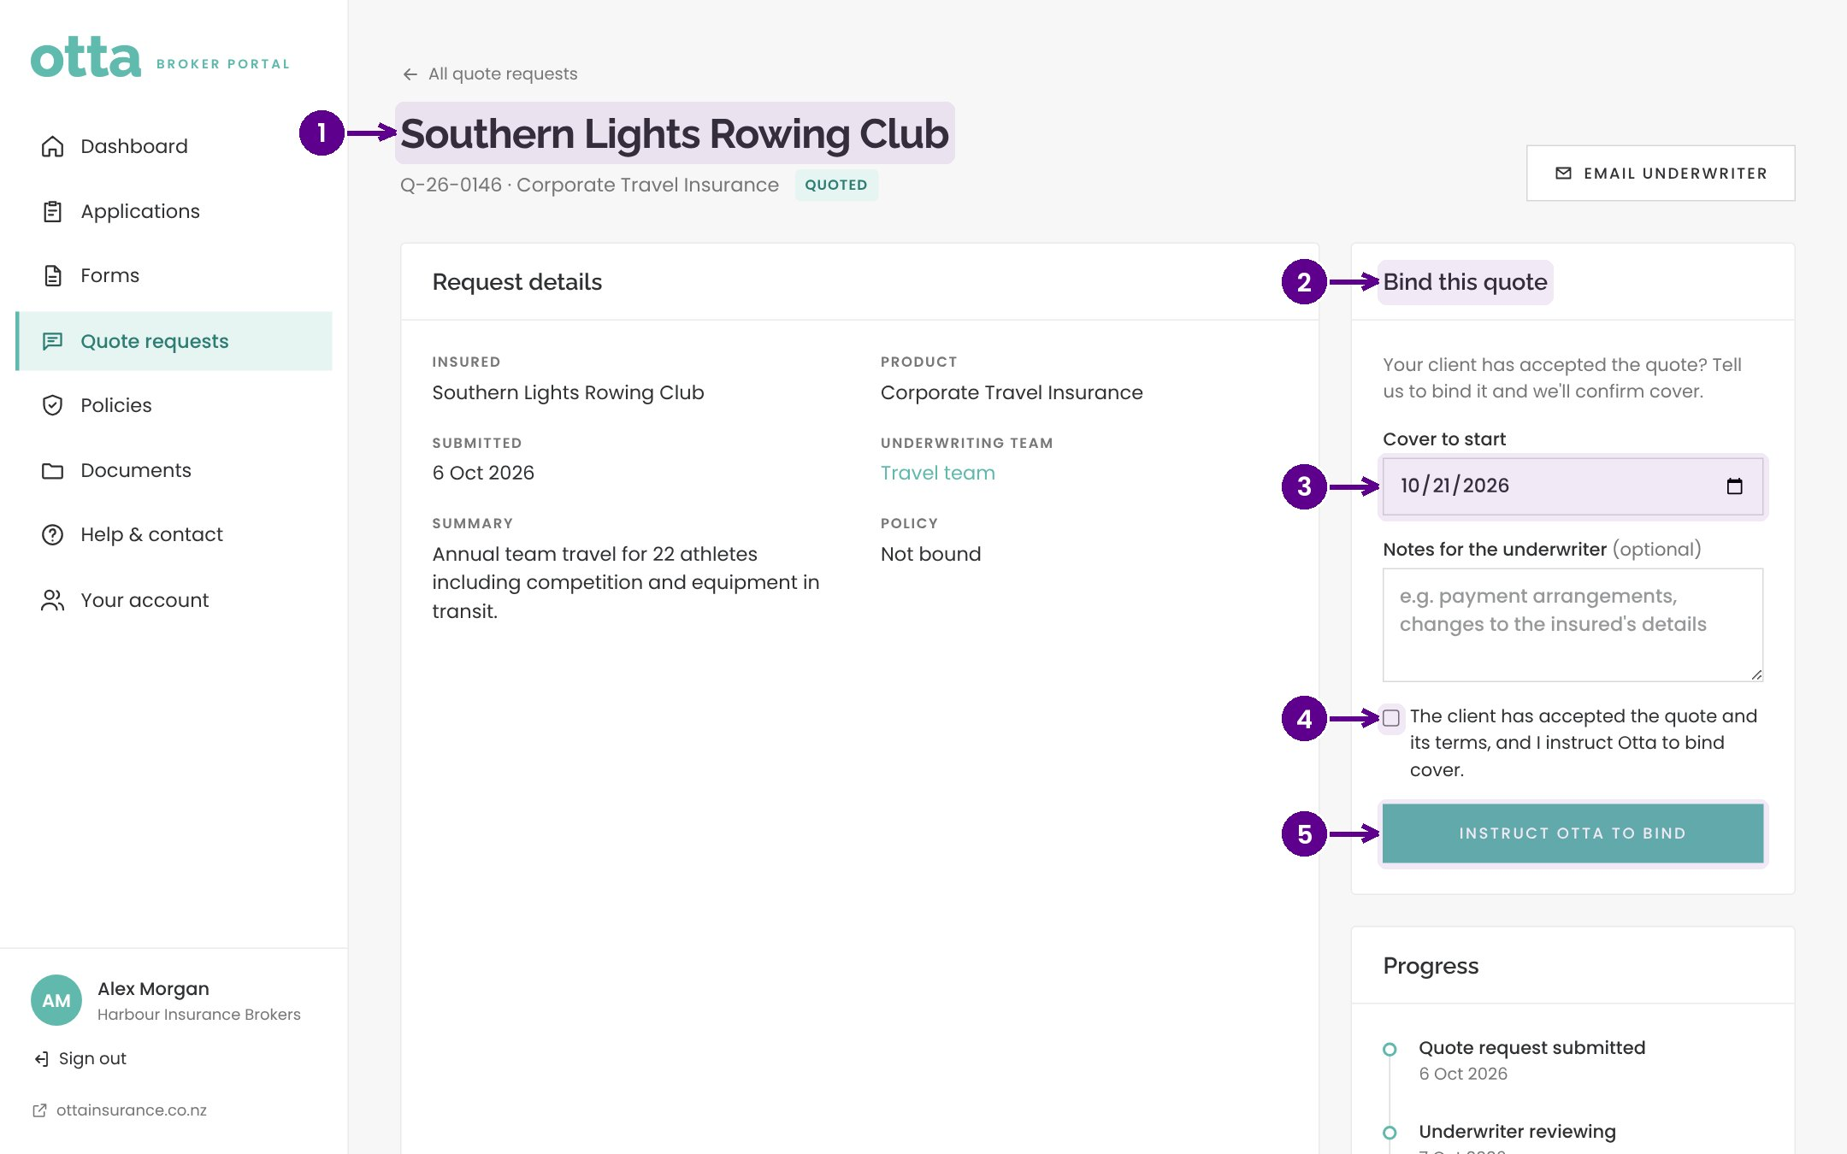
Binding a quote
1
Open the quote.
2
Bind this quote, once your client accepts.
3
Choose the inception date.
4
Confirm your client has accepted the quote and terms.
5
Instruct Otta to bind. We're told straight away.
Notes:
When your client accepts a quote, open it and instruct us to bind. Choose the inception date and confirm acceptance. We'll confirm cover and send the documents.

Slide 16
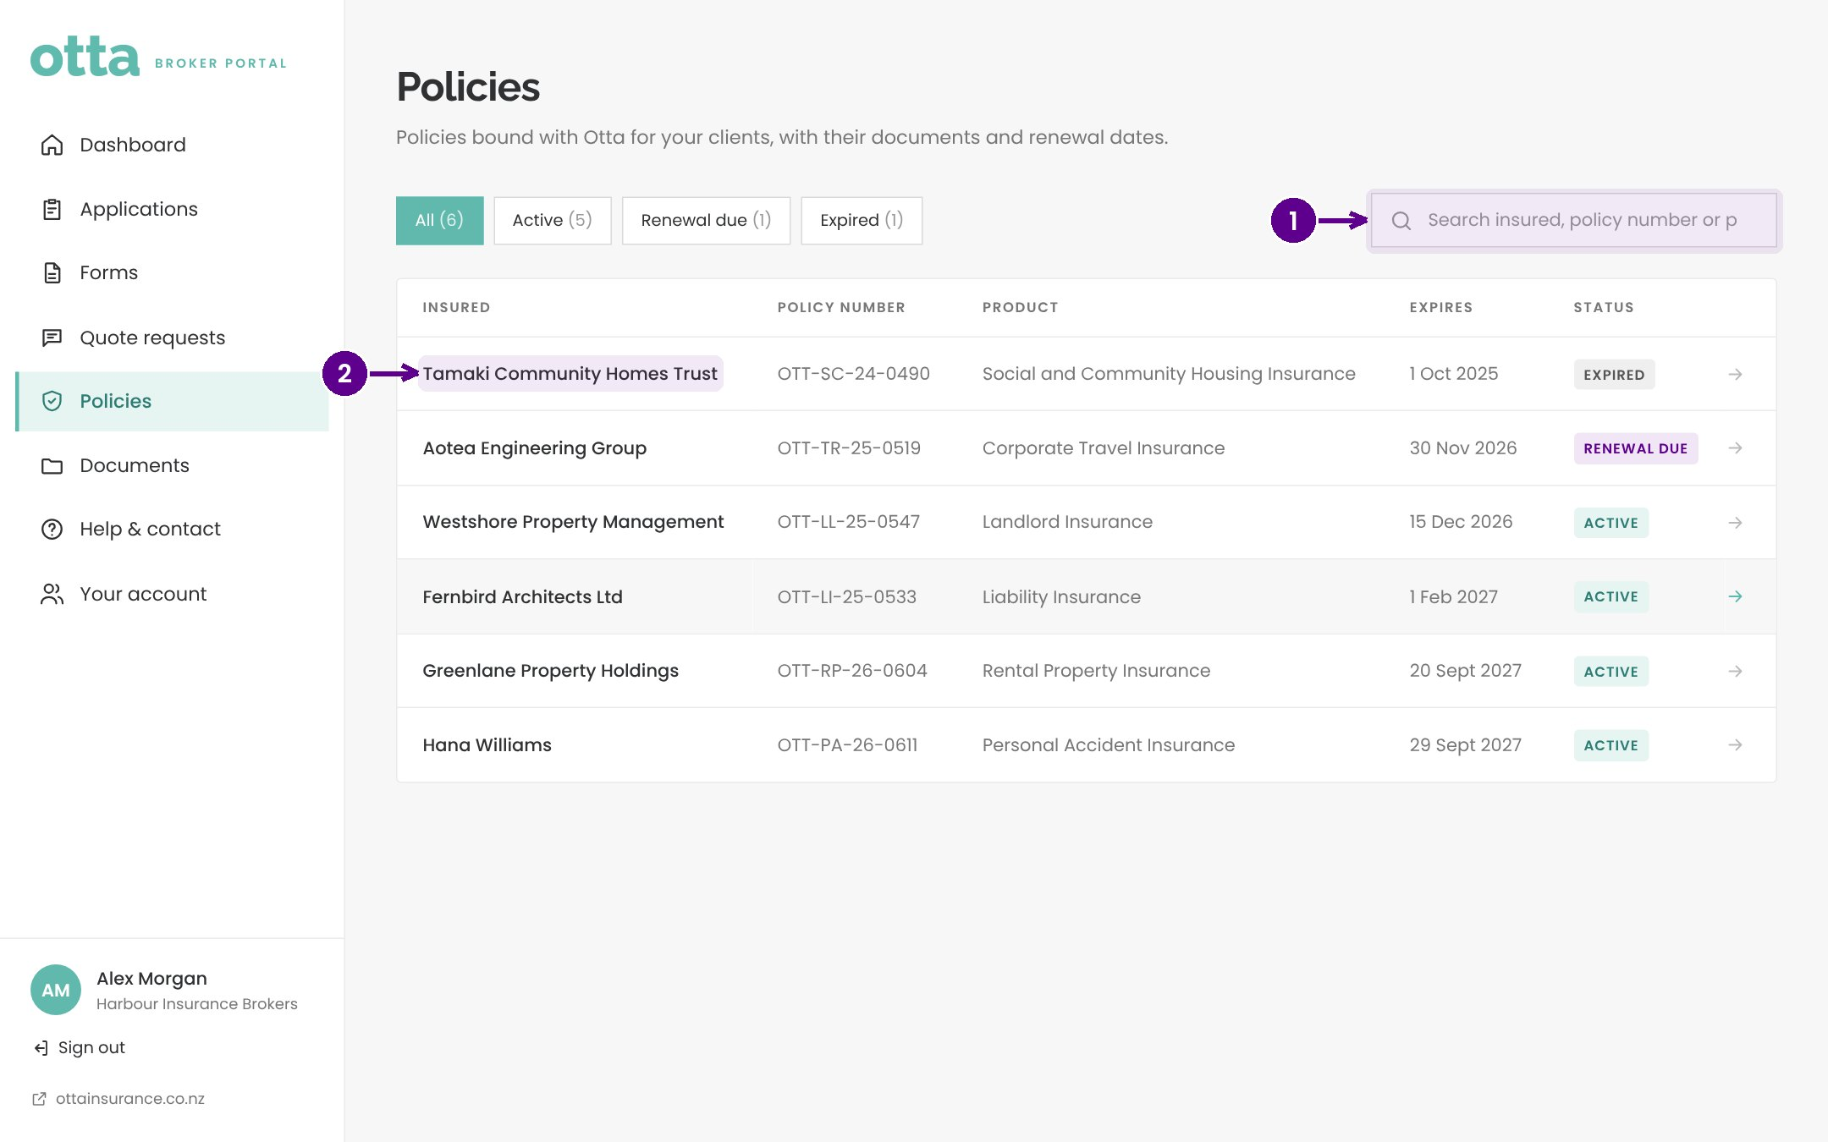
Your policies
1
Search your policies.
2
Open a policy for its details and documents.
Notes:
Policies lists every policy you have with Otta, with expiry dates. Renewals due soon also show on your dashboard.

Slide 17
Help when you need it
05
You talk directly to the underwriters who make the decisions.
Notes:
Help when you need it. You talk directly to the underwriters who make the decisions.

Slide 18
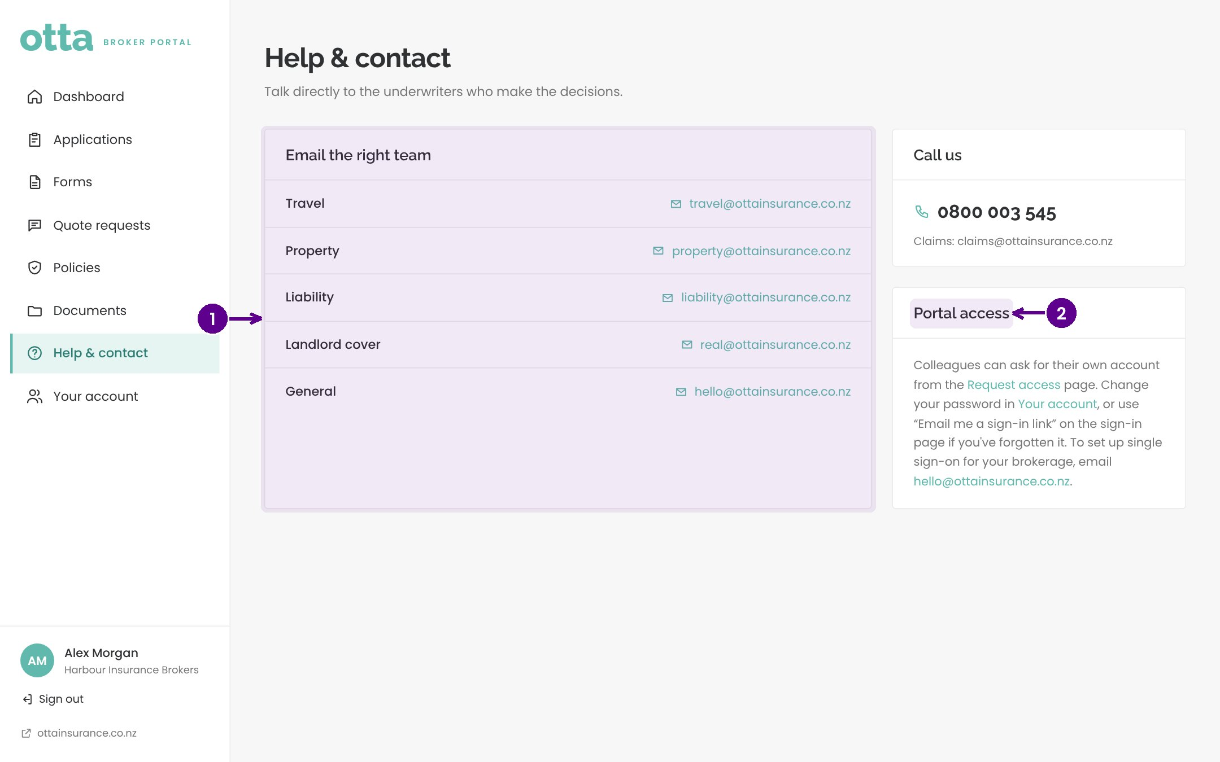
Help and contact
1
Email the right team directly.
2
Access for colleagues and password help.
Notes:
Help and contact lists each team's email address and our phone number. Colleagues can request their own account from the Request access page.

Slide 19
We're here to help
Call us on 0800 003 545.
✓
Email hello@ottainsurance.co.nz, or the team listed under Help & contact.
✓
Claims: claims@ottainsurance.co.nz.
✓
Thanks for choosing Otta. We look forward to working with you.
✓
Notes:
We're here to help. Call us on 0800 003 545. Email hello@ottainsurance.co.nz, or the team listed under Help & contact. Claims: claims@ottainsurance.co.nz. Thanks for choosing Otta. We look forward to working with you.

